Slide 1
Linear Regression

Slide 2
Introduction
Linear regression is perhaps one of the most well known and well understood algorithms in statistics and machine learning.
Isn't Linear Regression from Statistics?
Machine learning, more specifically the field of predictive modeling is primarily concerned with minimizing the error of a model or making the most accurate predictions possible, at the expense of explainability.
In applied machine learning we will borrow, reuse and steal algorithms from many different fields, including statistics and use them towards these ends.
As such, linear regression was developed in the field of statistics and is studied as a model for understanding the relationship between input and output numerical variables, but has been borrowed by machine learning.
It is both a statistical algorithm and a machine learning algorithm.

Slide 3
Regression Models
Notes:
13

Slide 4
Regression Models
Relationship between one dependent variable and explanatory variable(s)
Use equation to set up relationship
    Numerical Dependent (Response) Variable
    1 or More Numerical or Categorical Independent (Explanatory) Variables
Used Mainly for Prediction & Estimation

Slide 5
Regression Modeling Steps
1. Hypothesize Deterministic Component
    Estimate Unknown Parameters
2. Specify Probability Distribution of Random Error Term
    Estimate Standard Deviation of Error
3. Evaluate the fitted Model
4. Use Model for Prediction & Estimation

Slide 6
Types of
Regression Models
Notes:
18
This teleology is based on the number of explanatory variables & nature of relationship between X & Y.

Slide 7
Types of
Regression Models
Regression
Models
Notes:
19
This teleology is based on the number of explanatory variables & nature of relationship between X & Y.

Slide 8
Types of
Regression Models
1 Explanatory
Regression
Variable
Models
Simple
Notes:
20
This teleology is based on the number of explanatory variables & nature of relationship between X & Y.

Slide 9
Types of
Regression Models
1 Explanatory
Regression
2+ Explanatory
Variable
Models
Variables
Simple
Multiple
Notes:
21
This teleology is based on the number of explanatory variables & nature of relationship between X & Y.

Slide 10
Types of
Regression Models
1 Explanatory
Regression
2+ Explanatory
Variable
Models
Variables
Simple
Multiple
Linear
Notes:
22
This teleology is based on the number of explanatory variables & nature of relationship between X & Y.

Slide 11
Types of
Regression Models
1 Explanatory
Regression
2+ Explanatory
Variable
Models
Variables
Simple
Multiple
Non-
Linear
Linear
Notes:
23
This teleology is based on the number of explanatory variables & nature of relationship between X & Y.

Slide 12
Types of
Regression Models
1 Explanatory
Regression
2+ Explanatory
Variable
Models
Variables
Simple
Multiple
Non-
Linear
Linear
Linear
Notes:
24
This teleology is based on the number of explanatory variables & nature of relationship between X & Y.

Slide 13
Types of
Regression Models
1 Explanatory
Regression
2+ Explanatory
Variable
Models
Variables
Simple
Multiple
Non-
Non-
Linear
Linear
Linear
Linear
Notes:
24
This teleology is based on the number of explanatory variables & nature of relationship between X & Y.

Slide 14
Linear Regression Model
Notes:
26

Slide 15
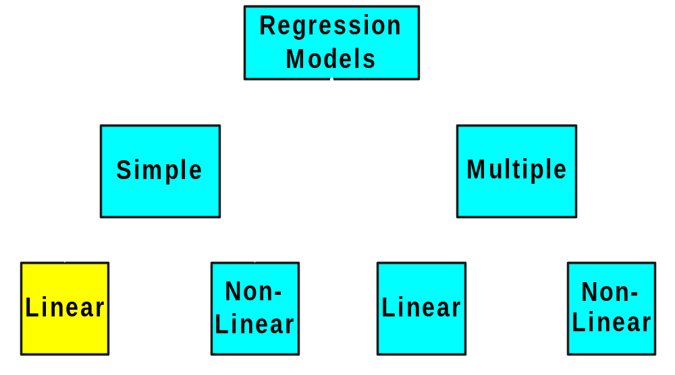
Types of
Regression Models
Notes:
27
This teleology is based on the number of explanatory variables & nature of relationship between X & Y.

Slide 16
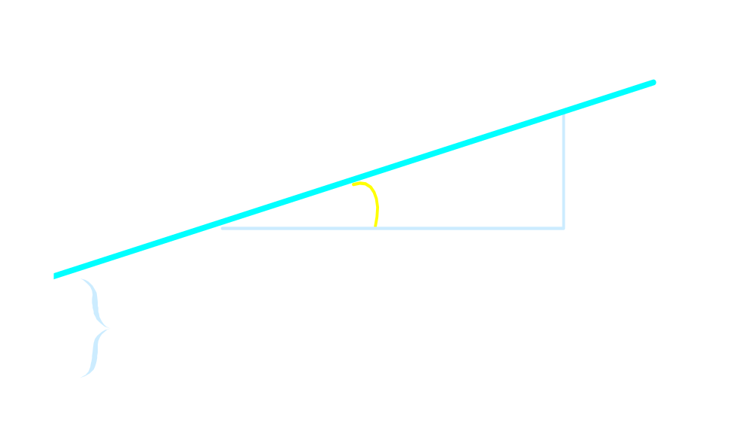

Linear Equations
© 1984-1994 T/Maker Co.
Notes:
28

Slide 17
Linear Regression Model
1. Relationship Between Variables Is a Linear Function
Population
Y-Intercept
Population Slope
Random Error
Y
=
β
+
β
X
+
ε
i
0
1
i
i
Dependent (Response) Variable
Independent (Explanatory) Variable

Slide 18
Population & Sample Regression Models
Notes:
30

Slide 19
Population & Sample Regression Models
Population
☺
☺
☺
☺
☺
Notes:
31

Slide 20

Population & Sample Regression Models
Population
Unknown Relationship
☺
☺
☺
☺
☺
Notes:
32

Slide 21
Population & Sample Regression Models
Population
Random Sample
Unknown Relationship
☺
☺
☺
☺
☺
☺
☺
Notes:
33

Slide 22
Population & Sample Regression Models
Population
Random Sample
Unknown Relationship
☺
☺
☺
☺
☺
☺
☺
Notes:
34

Slide 23
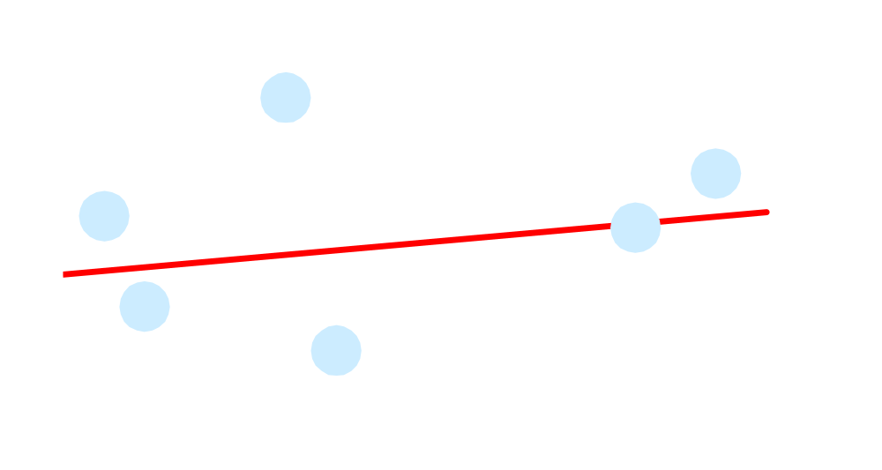
Population Linear Regression Model
Observedvalue
ε_{i} = Random error
Observed value
Notes:
35

Slide 24
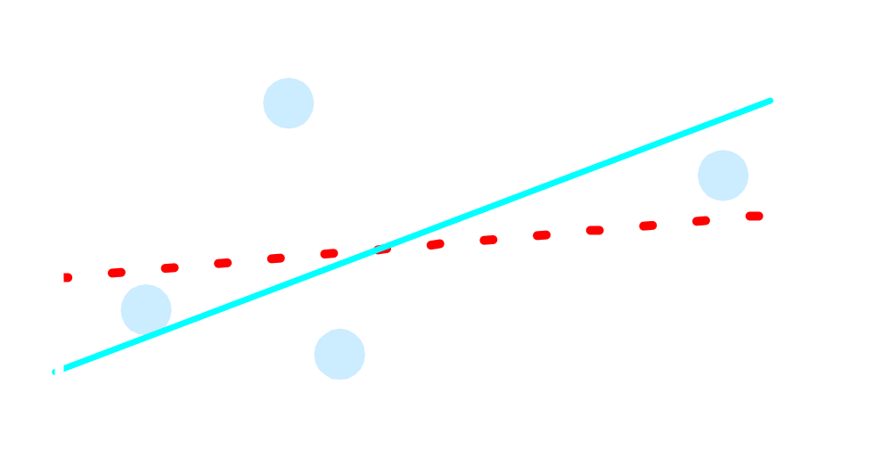
Sample Linear Regression Model
ε_{i} = Random error
^
Unsampled observation
Observed value
Notes:
36

Slide 25
Estimating Parameters:
Least Squares Method
Notes:
40

Slide 26
Scatter plot
1. Plot of All (X_{i}, Y_{i}) Pairs
2. Suggests How Well Model Will Fit
Y
60
40
20
0
X
0
20
40
60

Slide 27
Thinking Challenge
How would you draw a line through the points? How do you determine which line ‘fits best’?
Y
60
40
20
0
X
0
20
40
60
Notes:
42

Slide 28
Thinking Challenge
How would you draw a line through the points? How do you determine which line ‘fits best’?
Slope changed
Y
60
40
20
0
X
0
20
40
60
Intercept unchanged
Notes:
43

Slide 29
Thinking Challenge
How would you draw a line through the points? How do you determine which line ‘fits best’?
Slope unchanged
Y
60
40
20
0
X
0
20
40
60
Intercept changed
Notes:
44

Slide 30
Thinking Challenge
How would you draw a line through the points? How do you determine which line ‘fits best’?
Slope changed
Y
60
40
20
0
X
0
20
40
60
Intercept changed
Notes:
45

Slide 31
Least Squares
1. ‘Best Fit’ Means Difference Between Actual Y Values & Predicted Y Values Are a Minimum. But Positive Differences Off-Set Negative ones
Notes:
49

Slide 32
Least Squares
1. ‘Best Fit’ Means Difference Between Actual Y Values & Predicted Y Values is a Minimum. But Positive Differences Off-Set Negative ones. So square errors!
Notes:
50

Slide 33
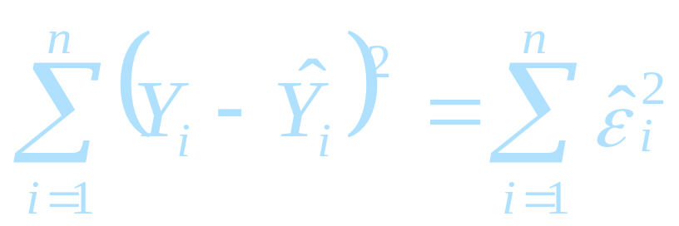
Least Squares
1. ‘Best Fit’ Means Difference Between Actual Y Values & Predicted Y Values Are a Minimum. But Positive Differences Off-Set Negative. So square errors!
2. LS Minimizes the Sum of the Squared Differences (errors) (SSE)
Notes:
51

Slide 34
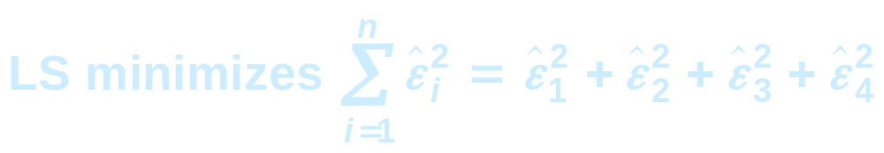
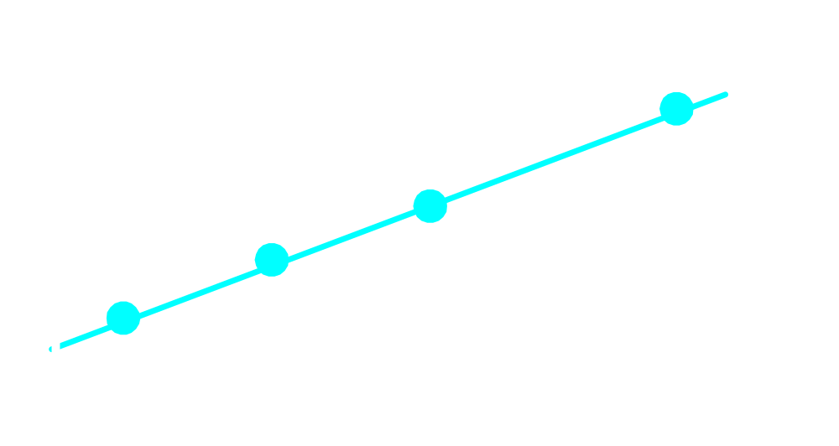
Least Squares Graphically
Notes:
52

Slide 35
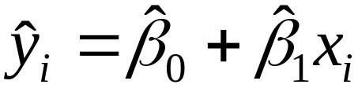
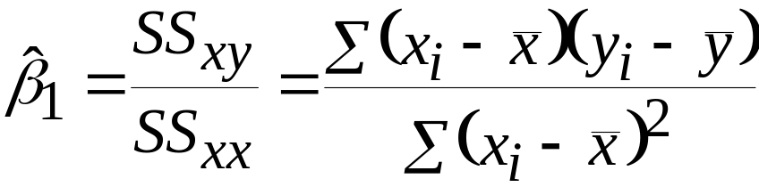
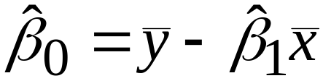
Coefficient Equations
Prediction equation
Sample slope
Sample Y - intercept

Slide 36
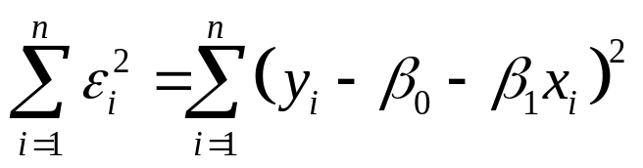
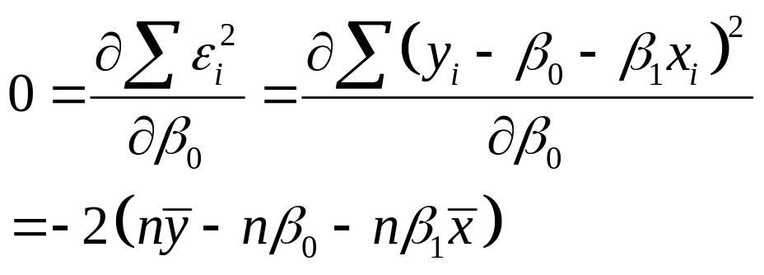
Derivation of Parameters (1)
Least Squares (L-S):
Minimize squared error

Slide 37
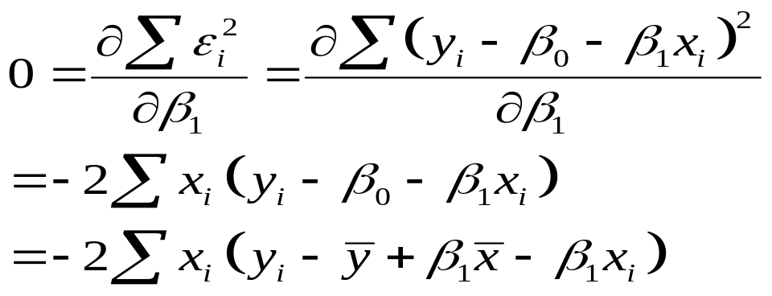
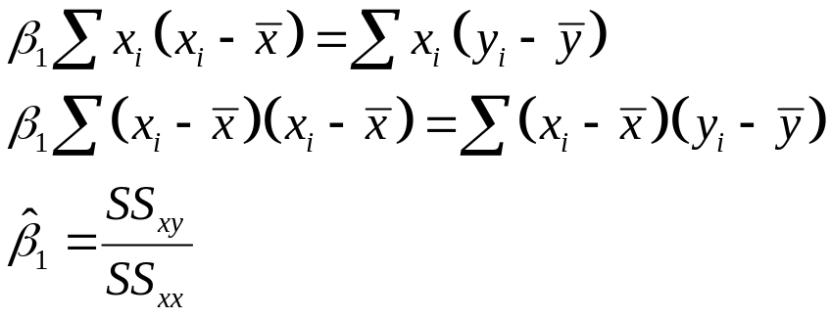
Derivation of Parameters (1)
Least Squares (L-S):
Minimize squared error

Slide 38
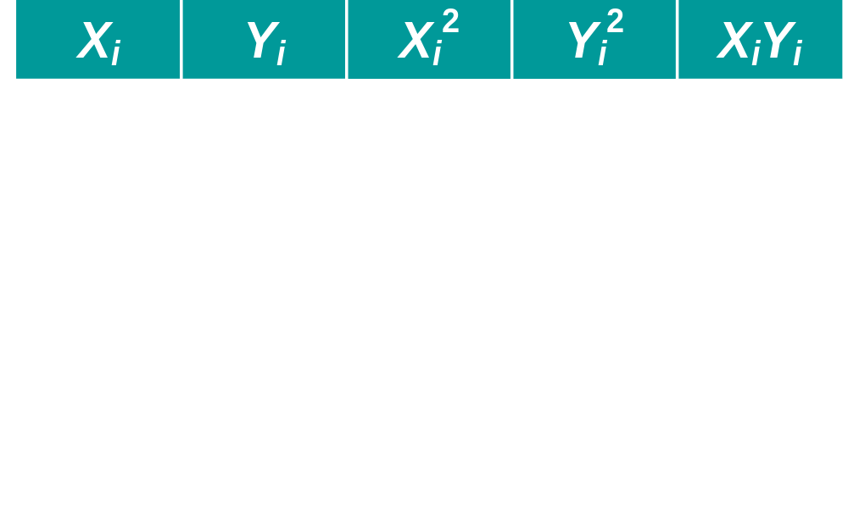
Computation Table
Notes:
54

Slide 39
Interpretation of Coefficients

Slide 40
Interpretation of Coefficients
^
1. Slope (β₁)
  Estimated Y Changes by β₁ for Each 1 Unit Increase in X
    If β₁ = 2, then Y Is Expected to Increase by 2 for Each 1 Unit Increase in X
^
^

Slide 41
Interpretation of Coefficients
^
1. Slope (β₁)
  Estimated Y Changes by β₁ for Each 1 Unit Increase in X
    If β₁ = 2, then Y Is Expected to Increase by 2 for Each 1 Unit Increase in X
2. Y-Intercept (β₀)
  Average Value of Y When X = 0
    If β₀ = 4, then Average Y Is Expected to Be 4 When X Is 0
^
^
^
^

Slide 42
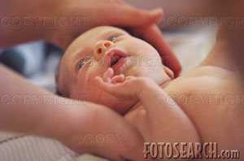
Parameter Estimation Example
Obstetrics: What is the relationship between
Mother’s Estriol level & Birthweight using the following data?
Estriol Birthweight
(mg/24h) (g/1000)
1 1
2 1
3 2
4 2
5 4

Slide 43

Scatterplot
Birthweight vs. Estriol level
Birthweight
Estriol level
Notes:
57

Slide 44
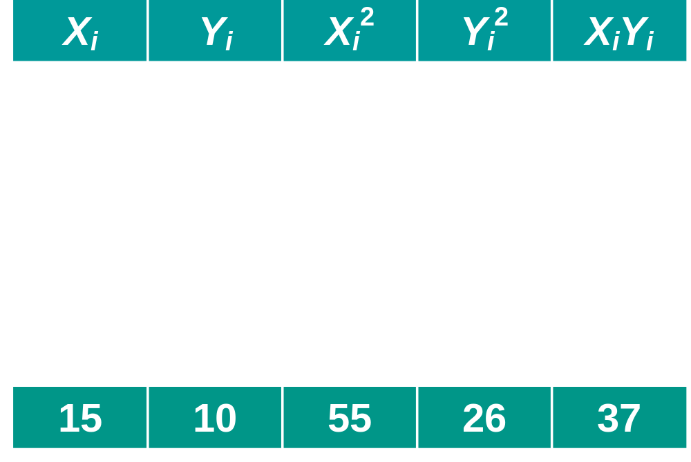
Parameter Estimation Solution Table
Notes:
58

Slide 45
Parameter Estimation Solution
Notes:
59

Slide 46
Coefficient Interpretation Solution

Slide 47
Coefficient Interpretation Solution
^
1. Slope (β₁)
  Birthweight (Y) Is Expected to Increase by .7 Units for Each 1 unit Increase in Estriol (X)

Slide 48
Coefficient Interpretation Solution
^
1. Slope (β₁)
  Birthweight (Y) Is Expected to Increase by .7 Units for Each 1 unit Increase in Estriol (X)
2. Intercept (β₀)
  Average Birthweight (Y) Is -.10 Units When Estriol level (X) Is 0
    Difficult to explain
    The birthweight should always be positive
^

Slide 49

Parameter Estimation Thinking Challenge
You’re a Vet epidemiologist for the county cooperative. You gather the following data:
Food (lb.) Milk yield (lb.)
4 3.0
6 5.5
10 6.5
12 9.0
What is the relationship
between cows’ food intake and milk yield?
© 1984-1994 T/Maker Co.
Notes:
62

Slide 50

Scattergram
Milk Yield vs. Food intake*
M. Yield (lb.)
Food intake (lb.)
Notes:
65

Slide 51
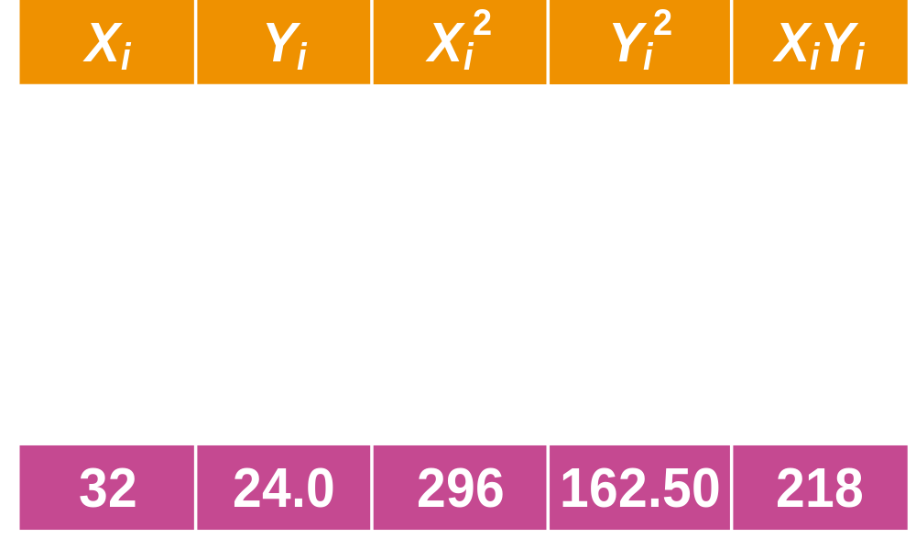
Parameter Estimation Solution Table*
Notes:
66

Slide 52
Parameter Estimation Solution*
Notes:
67

Slide 53
Coefficient Interpretation Solution*

Slide 54
Coefficient Interpretation Solution*
^
1. Slope (β₁)
  Milk Yield (Y) Is Expected to Increase by .65 lb. for Each 1 lb. Increase in Food intake (X)

Slide 55
Coefficient Interpretation Solution*
^
1. Slope (β₁)
  Milk Yield (Y) Is Expected to Increase by .65 lb. for Each 1 lb. Increase in Food intake (X)
2. Y-Intercept (β₀)
  Average Milk yield (Y) Is Expected to Be 0.8 lb. When Food intake (X) Is 0
^

Slide 56
Preparing Data For Linear Regression
Linear Assumption
Remove Noise
Remove Collinearity
Gaussian Distributions
Rescale Inputs

